Slide 1


Oral Presentations

Slide 2
Contents
Presentations
Outlining Oral Presentation
Planning and Making Presentations
Signposting
Active Listening
Enhancing Oral Communication
Using Visual Aids
Using Nonverbal Communication

Slide 3
Presentations
A presentation is a talk or speech delivered to an audience to present a new product, idea or a piece of work.
Purpose and audience determines the style and content
Informative presentation: briefing someone, sharing a report, training a group
Persuasive presentation: motivating, convincing, expressing goodwill towards someone/something
Group presentations: Maintaining rapport
use non-verbal techniques (eye-contact and body language)
Need to consult with the supervisors, managers and colleagues about the content.

Slide 4
Differences between internal and external presentations
Internal
External
1. Involves audiences inside of your organization
2. Can be formal and informal
3. Audiences are employees and the company’s management
4. Takes place within an organization
Involves audiences outside of organization
Mostly formal
Audiences are customers, shareholders, investors, general public etc.
Takes place in locations like hotels, conference centers etc.

Slide 5
The 6 Ps of Presentation
1. Plan well: Make up your mind
Create an outline
Know the background
2. Identify the purpose: Why are you presenting?
To inform, instruct, persuade, seek feedback etc.
3. Demonstrate your personal communication skills: Maintain good rapport
Use effective nonverbal communication skills
4. Show personal commitment: Commitment: promise to do something
Maintain it
Too much commitment makes you biased, overzealous and creates stress
5. Be aware of political sensitivities: Controversial issues need to be handled in a sensible and careful way
Avoid unnecessary risks
6. Polish your presentation as much as possible: Make simple, clear and easy to understand
Practice , practice and practice

Slide 6
Outlining Oral Presentation
a. Introduction (present the background and purpose)
b. Body (present the main points and supporting details)
c. Conclusion (present the main idea and recommendations)
d. Question and answer session (to answer any queries from audiences)

Slide 7
a. Introduction
Greet the audience
Grab the attention
Introduce yourself
Statement of objective (thesis statement)
Overview of all your main points
Emphasize key words or phrases that you will use later

Slide 8
b. Body
Elaborate on background of your topic (include main point, sub-point, bullets etc.)
If on research or technical information, state the theory, assumptions, methods or procedures etc.
Use examples, graphics, pictures, tables, charts etc.
Include a brief discussion (what the points mean)

Slide 9
c. Conclusion
Give conclusions and offer recommendations
End smoothly with a statement that sums up the presentation
Invite the audience for the questions

Slide 10
d. Question-and-answer session
Invite questions
Listen carefully
Clarify the confusion
Be honest (if you are not clear about answer)

Slide 11
Planning and Making Presentations
Effective presentations require good planning and presentation, particularly about how to grab the attention of audience.
Concentrate on three key points:
Presentation tools or techniques: postures, PowerPoint, demonstration, role-play, oral delivery, videos etc.
Writing skills: systematic, concise, bullets, highlight main ideas etc.
Way of delivery: concentrate on not only what to say but also how to say, body language
Determine the purpose, choose the topic, gather information, organize them, write the script, revise, rehearse and deliver.

Slide 12
Consider the following steps during preparation
1. Plan
Be sure of the purpose, topic, content, time, audience, visual aids etc.
2. Prepare
Outline the presentation, adopt tools & techniques, develop confidence, test technologies & venues, know your audience and context.
3. Practice
Read aloud in front of mirror/peers/family members, check time, watch some videos, be prepared
4. Present
Appear comfortable and confident and deliver the ideas
Tell them what you are going to tell, tell again that you have told them.

Slide 13
Tips on giving effective presentations
Get there on time
Greet audience
Introduce yourself
Highlight the title and give clues on what you are going to deliver
Speak slowly and clearly
Vary your tone
Make eye contact
Pay attention to the reaction of the audience
Enjoy and show enthusiasm
Pause briefly between sections
Control your own space and the audience
Respond to the queries – be honest
Keep a glass of water handy as well as tissue paper
Keep close eye on the time

Slide 14
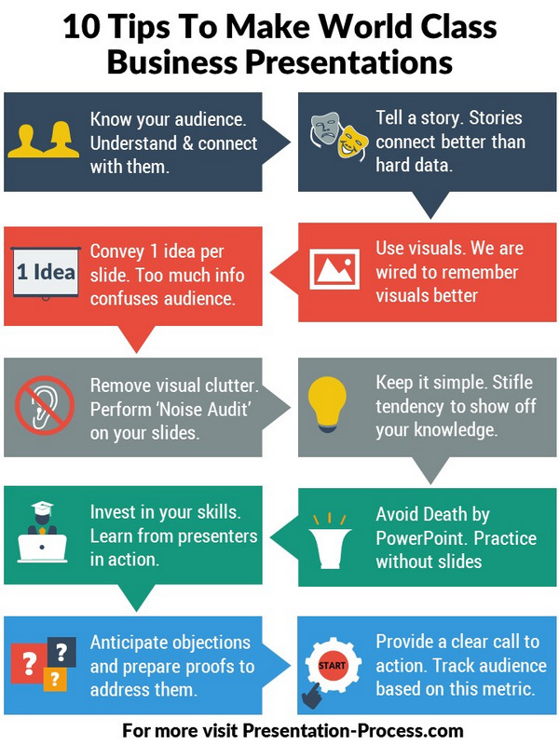

Slide 15
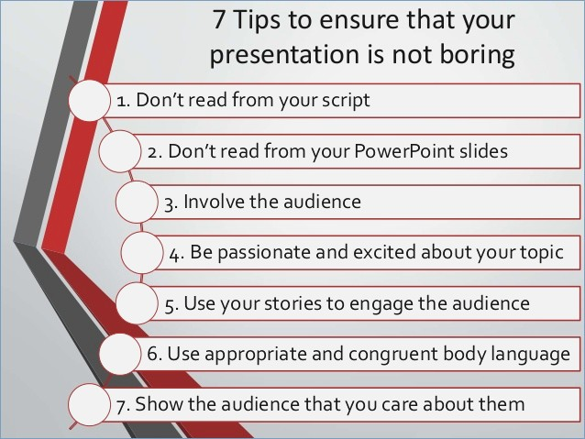

Slide 16
# SLIDES for PRESENTATION
Keep it simple
Limit bullet points and texts
Use high quality graphics
Have a visual themes.
Use appropriate chart
Use appropriate color
Choose font well
Use video and audio
Always don’t stare at slides
Don’t stand between the audience and slides

Slide 17
# What not to do during presentations
Do not fear
Do not rush
Do not stick your hands in your pockets
Do not underestimate your audience
Do not hurt audience’s feelings
Do not command
Do not repeat the same content
Do not avoid appropriate non-verbal communication
Don’t be egotistical (thinking that you are better than anyone else)

Slide 18
Signposting
Signposting is the use of linguistic devices (words and phrases) that signal the structure and development of your presentation to guide listeners.
It helps to indicate your listener what has been delivered, and what is going to come next.
Help to develop a clear structure not only for you as the speaker but also to the listener to follow you clearly.
Words like firstly, secondly, then, moreover, on the other hand, similarly, however, further, next, to conclude etc.
They also help to convey what you are trying to do or what you are thinking at a particular moment during your presentation. e.g. I think that, it suggests that, I agree with her that, to quote him etc.

Slide 19
Active Listening
Effective communication is not possible if the listener is not paying attention to the speaker
Listening requires you to engage your mind, to pay attention to the sound, to concentrate on the speaker, to gather information etc.
Hearing (involuntary) whereas listening (requires volition/will, effort and attention)
Poor listening leads to misunderstanding and break in communication
Poor listening indicates lack of focus, hence irrelevant questions
Active listening strengthens the relations
Researches show we retain only 20% of what we hear

Slide 20
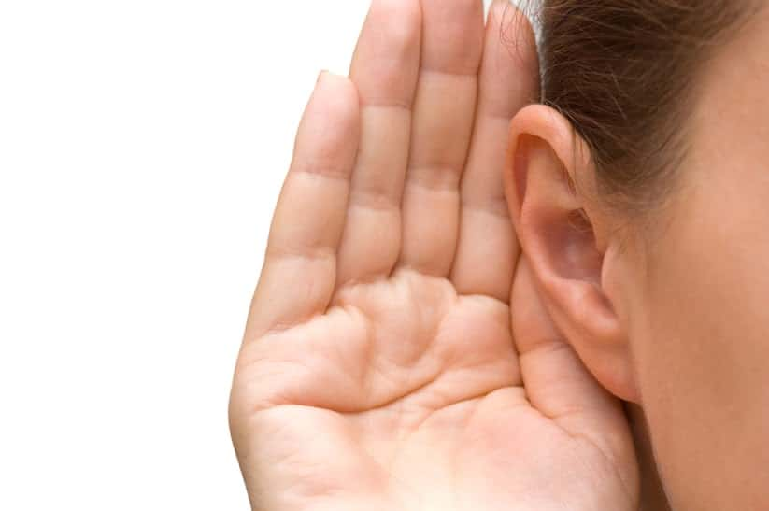
Reasons for Poor Listening
Lack of interest
Distractions (noise)
Content too easy/difficult
Selective hearing (adding to what we already know)
Presentations are boring and dull
Pressure/stress
No time
Negative attitude
Prejudices
Low volume
language
Poor vocabularies
Lack of trust

Slide 21
Ways to enhance active listening
i. Suspending judgements - suspend judgement, focus on facts
- don’t get preoccupied with emotions and value judgements
- avoid prejudices/biasness about the speaker
ii. Paying full attention - identify, select and interpret information and meaning
- show right gesture (eye contact, nodding head etc.)
iii. Being empathetic - putting yourself in speaker’s shoes
- seeking common ground with the speaker on attitude, feeling
- no argument with the speaker
iv. Seeking clarification - give feedback (verbal or non-verbal)
- show how you are handling the information
- summarize/paraphrase what you have interpreted

Slide 22
Enhancing oral Communication
Using visual aids
The most powerful means of communication
Tables (data), bar-chart (compare), pie chart (slices), flow chart (process) etc.
They add interest, attract attention, engage audience, simplify message
Pay attention to the size, number, colours, timing etc.
b. Using non-verbal communication
Smile, movement of hands, eye-contact, nodding head, tone, etc.
Identify and minimize nervous manners like biting nails, tapping feet, speaking too fast, repeating content, trembling, sweating etc.

Slide 23
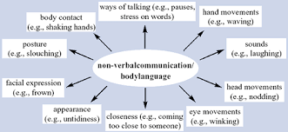

Slide 24
Effective Speaking
Speaking in such a way that your message is clearly heard and, if possible, acted upon.
Speak Clearly and Slowly: Speak clearly and avoid rushing your words to ensure your audience can easily understand your message.
Maintain Eye Contact: Maintaining eye contact indicates engagement and interest, fostering a stronger connection with your audience.
Use Natural Gestures: Use natural and purposeful gestures to enhance your message's engagement, but avoid excessive use.
Vary Your Tone and Pitch: Monotone speech can be monotonous and dull. Vary your tone and pitch to add interest and convey different emotions.
Practice Active Listening: Effective communication requires active listening before responding, fostering meaningful dialogues as a two-way exchange.
Avoid Empty Fillers (Um, Uh, Like, etc.): Fillers can distract the audience from your message and undermine your credibility so, speak without using these verbal aids.

Slide 25
Organize Your Thoughts: To present your ideas clearly and logically organize thoughts properly.
Tailor Your Message to Your Audience: Adapt your language, tone, and examples to vibrate with your audience's interests and needs for effective communication.
Use Pauses Effectively: Maintain pauses to emphasize key points and enable your audience to take information effectively.
Practice Deep Breathing: Deep breaths control nervousness and project your voice more effectively.
Minimize Distractions: Reduce distracting habits or movements, such as playing, excessive hand gestures, or walking.
Be Mindful of Your Posture: Stand or sit up straight to project confidence and openness.
Tell Stories and Use Examples: Use stories and examples to enhance the reliability and memorability of message, effectively illustrating complex concepts and engaging your audience.

Slide 26
Seek Feedback: Don't hesitate to ask for feedback from trusted friends, colleagues, or mentors. Constructive criticism can help you identify areas for improvement.
Practice, Practice, Practice: Rehearse your speeches or conversations before hand to foster confidence and fluency.
Record Yourself: Recording to identify areas and improve tone, pacing, and gestures.
Embrace Authenticity: To build trust and connection with your audience.
Manage Nervousness: Feeling nervous is natural, but practice, preparation, and positive self-talk to manage nerves effectively.
Stay Open to Adaptation: Be willing to adjust your attitude based on the feedback and reactions of your audience.
Celebrate Your Progress: Recognize and celebrate your progress in speaking skills, as positive reinforcement fuels ongoing growth.

Slide 27
Group Communication
Group communication is the act of sending and receiving messages to members of a group.
Group communication is a mode of communication among people, in an organization, between employers and employees, and employees in teams or people in general to discuss a topic or communicate a message.
According to the Oxford Dictionary of Media and Communication “The process by which verbal and nonverbal messages are exchanged between a limited number of people, usually from 3 to about 20, the upper limit being determined by the extent to which each member can interact with every other member with the potential for mutual influence. Traditionally, this refers to interpersonal communication between group members in face-to-face interaction.”
Group communication in marketing perspective as communicating to a group of people or target customers to market a product.
Small group communications can be looked at as groups of size 3 to 20 and larger groups looked can be 100 to 200 in size.

Slide 28
Importance of Group Communication
Effective group communication is vital in business environment.
Without proper communication understanding and feedback remain elusive, leading to message loss.
Group communication is particularly crucial in marketing endeavors, facilitating effective product selling and launches.
Social media have revolutionized customer interaction, providing channels such as social media platforms, messaging, webinars, podcasts, and customer service for group communication.

Slide 29
Types of Group Communication
1. Verbal
Verbal group communication involves people in a group speaking with each other discussing a topic and reaching a conclusion with every participant’s views and feedback.
In marketing, it can be a seminar attended by target audience.
It can be a group discussion or a focused group study where a product is discussed before launch.
2. Non Verbal
Non verbal communication is when a group communicates using non-verbal cues but get the message clearly and executes the decision effectively.
Imagine a busy crossroad junction in a big city. Traffic controllers along with automated lights and information communicate effectively with the passengers and regulate traffic flawlessly.
3. Technology driven
People communicate through social media, forums, customer service channels, webinars etc
Using technology, a lot of people can collaborate to achieve a common objective.

Slide 30
Example of effective virtual group communication
A webinar is a good example of modern day group communication.
In a webinar a person or a company present an idea/ product/ service to interested customers.
Questions are asked and interaction is there as all the members connected to a common idea.
People may become potential customers if the webinar is about a product.
All the queries and other features can be very well clarified in the webinar.
A typical seminar or webinar may have 40-50 members
Online classes; where in a teacher teaches a group of students using technology.
Even conventional education is based on effective group communication where a teacher teaches to a group.

Slide 31
Features of group communication
Participants — senders and receivers of the messages.
Message — the piece of information communicated across a group.
Context — external circumstances and conditions in which the communication takes place that largely determine how the message is interpreted.
Some of the factors that make up the context in group communication are:
the situation,
culture,
environment,
time,
place
roles of the participants.
Channel(s) — the medium used to disseminate the information; letters, email, phone, etc.).
Feedback — the response made by the receiver(s) of the message.

Slide 32
Advantages of group communication
Better transparency and clarity among group members about goals and expectations — Group members that frequently communicate are more likely to establish trust and transparency among themselves.
Improved teamwork and collaboration — Effective group communication is one of the key facilitators of successful teamwork and collaboration.
Increased productivity — effective group communication between team members drives productivity and ensures better results.
More effective decision-making — Multiple perspectives present in group communication contribute to better objectivity and accuracy when making decisions.
Closer relationships and improved trust between team members — communication among team members fosters organizational relationship and trust, with the quality, quantity, and adequacy of information .

Slide 33
Disadvantages of group communication
Physical barriers — When group members are not in the same physical location, challenges in communication arise, as insufficient communication tools and unreliable internet/ phone connections.
Perceptual barriers — The personality types and overall outlook on life of group members influence how each individual perceives work tasks and messages in group communication.
Emotional barriers — The current emotional state of the participants in the group communication affects how they will formulate and interpret messages.
Interpersonal barriers — individual’s self-perception; notably, overly confident person engages differently from those who are more insecure.
Cultural barriers — Conventions, casts, and nonverbal misinterpretations are some of the most common obstacles.
Language barriers — language barriers in group communication can occur when members speak different languages. Specific technical terminology, or jargon can also cause misunderstandings

Slide 34




Slide 35


